Slide 1




NHG Growing Pains: Vehicle Routing Optimization
Benchmarking NHG's in-house distribution model against a third-party logistics proposal — using capacitated VRP with time windows across three operational scenarios.
I E 7 2 0 0 — S U P P L Y C H A I N E N G I N E E R I N G S P R I N G 2 0 2 6

C O U R S E
IE 7200 — SCE
M E T H O D
CVRPTW + Heuristics
S C E N A R I O S
Q1 · Q2 · Q3
R E G I O N
6 Northeast States
T E A M
Harshavardhan Surya Babu Sivagami Sainath Boreda

Slide 2


Agenda
Structure of today's analysis and findings
P R E S E N T A T I O N O V E R V I E W
01
Problem & Context
NHG's distribution challenge — one depot, 123 stores, six Northeast states, growing weekly order volume
02
Operational Constraints
DOT hours of service, vehicle capacity, delivery time windows, and unloading parameters
03
Solution Methodology
Clarke-Wright savings, 2-Opt improvement, route consolidation, and inter-route Or-Opt
04
Q1 — Base Case (Vans Only)
Homogeneous van fleet on the existing fixed delivery schedule — the MAD benchmarking baseline
05
Q2 — Mixed Fleet
Introducing Straight Trucks for 60 mandatory orders — impact on route count, mileage, and cost
06
Q3 — Relaxed Schedule
Geographic clustering across weekdays — the largest cost-reduction lever available to NHG
07
Scenario Comparison & Dashboard
Side-by-side metrics, daily breakdowns, and visual analytics across all three scenarios
08
Insights & Recommendations
Key takeaways and strategic guidance for NHG's MAD negotiation and schedule optimization
02 / 15

Slide 3


NHG's Distribution Challenge
Rapid retail growth is straining NHG's logistics network. A single depot must serve stores across six New England states — and a third-party logistics partner (MAD) has submitted a competing proposal.
P R O B L E M S T A T E M E N T
261
WE E KLY OR DE R S
123
STOR E LOCATI ON S
65,429
FT³ WE E KLY VOLU M E
6
N OR TH E AST STATE S
THE CORE PROBLEM
STUDY OBJECTI VES
NHG's rapid store expansion has driven distribution costs up week-over-week. With a

Establish a credible weekly-mileage baseline (Q1) for MAD negotiations
single depot in ZIP 01887 (Woburn, MA) serving 123 locations scattered across MA, NH,

Quantify the cost penalty of introducing Straight Trucks (Q2)
CT, RI, VT, and ME — route efficiency is critical.
Measure savings from flexible delivery scheduling (Q3)

MAD (Massachusetts Area Distribution) has submitted a proposal to take over deliveries. This study benchmarks three in-house scenarios to establish negotiating

Identify maximum negotiating upside for NHG vs MAD's proposal
leverage and identify optimization opportunities.
03 / 15

Slide 4


Operational Constraints
All routes must satisfy these constraints at every construction and improvement step.
M O D E L P A R A M E T E R S



Vehicle Capacity
DOT Hours of Service
Delivery Time Window
→ Van: max 3,200 ft³ per route
→ Drive time ≤ 11 hours per shift
→ All stop arrivals: 08:00 AM – 06:00 PM
→ Straight Truck: max 1,400 ft³ per route
→ On-duty time ≤ 14 hours per shift
→ No early arrivals before depot opens at 08:00
→ No partial loads — total cube must fit on-board
→ Mandatory 10-hour break before next shift
→ Late arrivals disqualify the route as infeasible



Travel Speed
Unloading Time
Hard vs. Soft
→ Average road speed: 40 mph throughout network
→ Van: 0.030 min/ft³ at each stop
→ Capacity & DOT hours: hard constraints
→ Applied to all inter-stop segments uniformly
→ Straight Truck: 0.043 min/ft³ at each stop
→ Time windows: hard constraints
→ Drive time = distance ÷ 40 mph
→ Minimum 30 minutes per delivery stop
→ All validated at every heuristic iteration step
04 / 15

Slide 5



A four-phase heuristic approach
H O W W E S O L V E D I T
Clarke-Wright Savings
Start by asking: for every pair of stores, how much distance do we save by visiting them on the same trip instead of two separate runs from the depot? Merge the highest-saving pairs first to build initial routes.
1
We modeled this as a Capacitated VRP
with Time Windows — solved fresh each day. Rather than searching for a theoretically perfect answer, we built
Intra-Route 2-Opt
Each route is then tightened by checking whether reversing any sub-segment reduces total travel. This removes the "crossing paths" problem that Clarke-Wright sometimes leaves behind.
2
good routes fast and then iteratively
improved them.
Route Consolidation
Where two under-loaded routes can be safely merged into one without overflowing vehicle capacity, we collapse them — reducing the number of depot departures needed that day.
Every move — at every phase — is
3
checked against DOT hours, vehicle
capacity, and the 8 AM–6 PM delivery window before it's accepted.
Inter-Route Or-Opt
Finally, small chains of 1–3 consecutive stops are moved between routes to find any remaining savings. This cross-route tuning is where the last few miles get squeezed out.
4
Why per-day? Order volume and geographic spread vary significantly day-to-day. Solving per-day lets the algorithm cluster stops more tightly and respect each day's load profile.
05 / 15

Slide 6


Q1: Base Case — Vans Only
Homogeneous 3,200 ft³ van fleet with the existing fixed Mon–Fri delivery schedule. This is the MAD benchmarking baseline.
S C E N A R I O O N E  B AS E L I N E
6,714
WE E KLY M I L E S
349,128
AN N UAL M I L E S ( × 52 )
28
TOTAL R OU TE S / WE E K
6
PE AK VE H I CL E S N E E DE D
D A I LY B R E A KD O WN
AV G. D R I V E R U T I L I Z AT I O N
DAY
ROU TE S
ORDE RS
VOLU M E ( F T³ )
M I LE S
Avg Drive h / Route
6.22 h
of 11h limit
Avg Duty h / Route
10.85 h
of 14h limit
Monday | 5 | 43 | 10,223 | 1,361
Tuesday | 6 | 58 | 11,537 | 1,543
Wednesday | 6 | 50 | 15,192 | 1,196
Thursday | 6 | 63 | 15,009 | 1,411
Friday | 5 | 47 | 13,468 | 1,203
Avg Mi / Route
239.8 mi
Overnight Routes
0
TOTAL 28 261 65,429 6,714
 Tuesday is the highest-mileage day (1,543 mi); Wednesday is the most efficient
(1,196 mi).
06 / 15

Slide 7

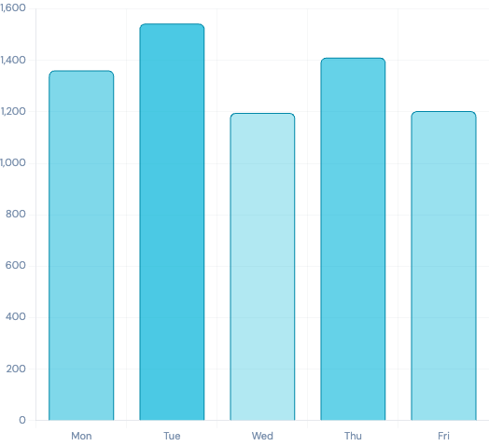
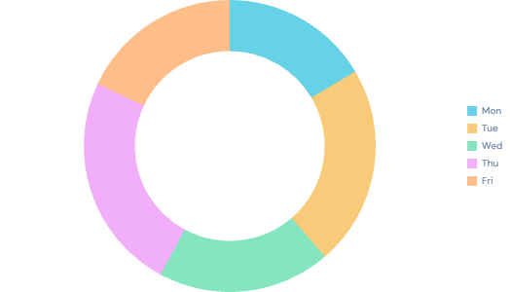
Q1 Daily Route & Mileage Breakdown
Q 1 A N A L Y T I C S  DAI LY P E R F OR M AN C E
D A I LY M I L E S — Q 1 B AS E CAS E
O R D E R S P E R D AY
E F F I C I E N CY I N D I CAT O R S
272
PEAK MI / ROUTE ( MON)
199
BEST MI / ROUTE ( WED)
0%
OVERNI GHT ROUTES
07 / 15

Slide 8

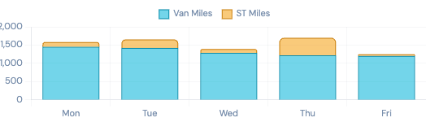
Q2: Heterogeneous Fleet
60 orders (23%) require Straight Trucks due to access/dock constraints. The remaining 201 (77%) are flexible. Smaller ST capacity fragments routes and inflates total mileage.
S C E N A R I O T W O  M I XE D F L E E T
7,584
WE E KLY M I L E S
+13.0%
VS Q 1 BAS E L I N E
34
TOTAL R OU TE S / WE E K
8
PE AK VE H I CL E S
D A I LY B R E A KD O WN
🚐 Van
DAY
ROU TE S
TOTAL M I LE S
VAN M I LE S
ST M I LE S
Capacity: 3,200 ft³
Unload: 0.030 min/ft³ Routes: 201 orders eligible
Monday | 6 | 1,585 | 1,451 | 134
Tuesday | 7 | 1,656 | 1,422 | 234
Wednesday | 7 | 1,392 | 1,286 | 106
Thursday | 8 | 1,702 | 1,219 | 483
Friday | 6 | 1,249 | 1,202 | 47
🚛 Straight Truck Capacity: 1,400 ft³
Unload: 0.043 min/ft³
Required: 60 orders
TOTAL 34 7,584 6,580 1,004
VA N V S S T M I L E S S H A R E
08 / 15

Slide 9

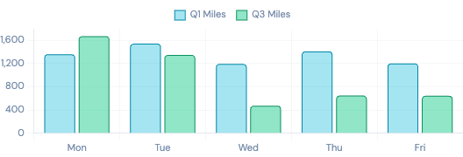

Q3: Relaxed Delivery Schedule
Stores may shift between weekdays while maintaining frequency. Nearby stores are clustered onto the same day — enabling geographic route consolidation and dramatic mileage savings.
S C E N A R I O T H R E E  B E S T S C E N AR I O
4,793
WE E KLY M I L E S
−28.6%
VS Q 1 BAS E L I N E
26
TOTAL R OU TE S / WE E K
1,921
WE E KLY M I L E S S AVE D
D A I LY B R E A KD O WN
D A I LY M I L E S — Q 3 V S Q 1
DAY
ROU TE S
ORDE RS
VOLU M E ( F T³ )
M I LE S
Monday | 9 | 89 | 24,485 | 1,674
Tuesday | 5 | 54 | 11,069 | 1,350
Wednesday | 3 | 33 | 8,167 | 475
Thursday | 6 | 68 | 16,017 | 649
Friday | 3 | 17 | 5,691 | 645
TOTAL 26 261 65,429 4,793
99,892
ANNUAL MI LES SAVED
249,236
ANNUAL MI LES (Q3 )
Wed
MOST EFFI CI ENT DAY
09 / 15

Slide 10
WHAT EACH SCENARI O TELLS US
Q1 sets the bar for MAD negotiations
At 349,128 annual miles, this is what NHG's current operation actually costs. Any third-party bid should be measured against this number — not an inflated estimate.
T H E B O T T O M L I N E
Schedule flexibility saves ~100K miles a year.
Q2 shows that vehicle mix matters — a lot
The 60 Straight Truck orders add 870 miles per week and require 2 extra vehicles. If MAD's contract covers ST routes, that cost premium needs to be explicit — otherwise NHG absorbs it silently.
Q 1 — B A S E L I N E
6,714 mi / week
Fixed schedule · vans only · 28 routes
Q3 is the negotiating leverage NHG didn't know it had
Relaxing the fixed delivery schedule — without adding vehicles or changing store frequency — cuts annual mileage by nearly 100,000. That's the upside NHG should push MAD to price in.
Q 2 — M I X E D F L E E T
7,584 mi / week
+13% · Straight Trucks fragment
routes · 34 routes
+ 1 3 %
Q 3 — R E L A X E D S C H E D U L E ★
4,793 mi / week
−28.6% · geographic
clustering · 26 routes
− 28 . 6 %
349K
Q1 ANNUAL MI
394K
Q2 ANNUAL MI
249K
Q3 ANNUAL MI

Slide 11

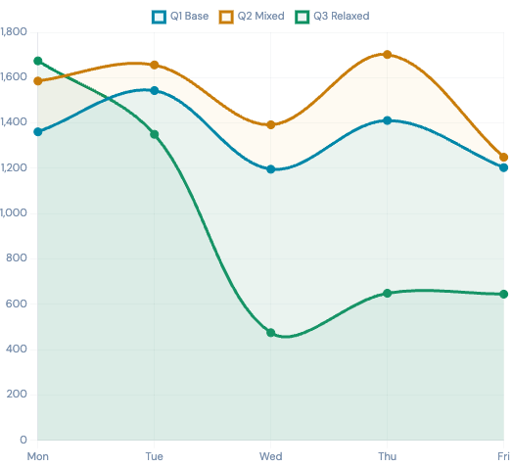
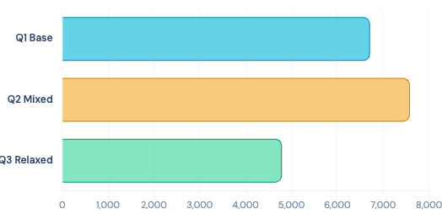
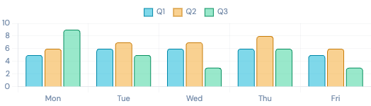
Three-Scenario Daily Miles Comparison
V I S U A L A N A L Y T I C S
D A I LY M I L E S : Q 1 V S Q 2 V S Q 3
WE E KLY T O TA L M I L E S B Y S C E N A R I O
R O U T E S P E R D AY B Y S C E N A R I O

Slide 12

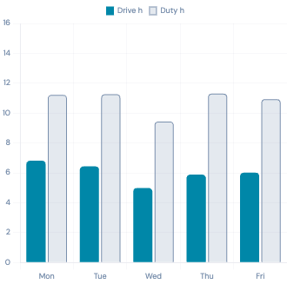
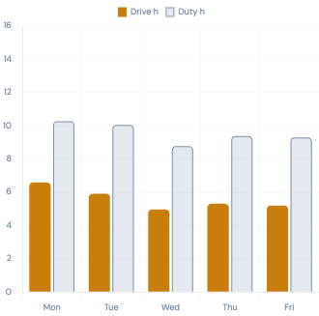
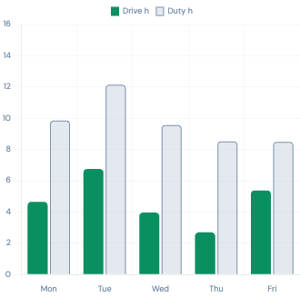

Driver Utilization & Avg Route Efficiency
Average drive hours, duty hours, and miles per route across all three scenarios, by day.
O P E R A T I O N A L E F F I C I E N C Y
Q 1 — VAN S ON LY
Q 2 — M I XE D F LE E T
Q 3 — RE LAXE D SCH E DU LE
Avg Drive: 6.22h
Avg Duty: 10.85h
Avg Drive: 5.60h
Avg Duty: 9.56h
Avg Drive: 4.69h
Avg Duty: 9.71h
239.8
Q 1 AVG M I / R OU TE
223.1
Q 2 AVG M I / R OU TE
184.3
Q 3 AVG M I / R OU TE
−23%
Q 3 VS Q 1 M I / R OU TE

Slide 13

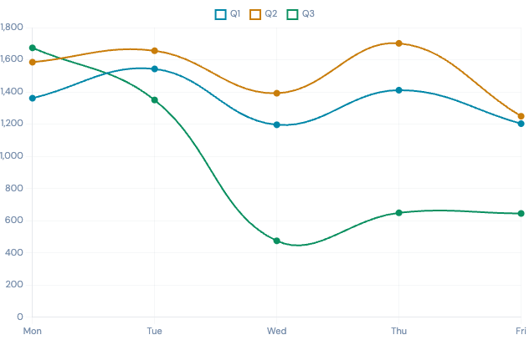
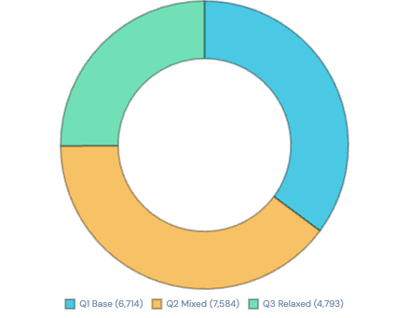
Route Performance Summary — All Scenarios
V R P A N A L Y T I C S D A S H B O A R D
Q 1 B AS E L I N E
Q 2 M I XE D
Q 3 R E L AXE D
6,714
Q 1 WE E KLY M I L E S
7,584
Q 2 WE E KLY M I L E S
DAI LY M I L E S T R E N D — AL L S CE N AR I O S
4,793
Q 3 WE E KLY M I L E S
99,892
AN N UAL M I L E S S AVE D (Q 3 )
CU M U L AT I V E WE E KLY M I L E S
MON | TUE | WED | THU | FRI
1,361 | 1,543 | 1,196 | 1,411 | 1,203
1,585 | 1,656 | 1,392 | 1,702 | 1,249
1,674 | 1,350 | 475 | 649 | 645

Slide 14

Insights & Analysis
Four core findings from the three-scenario VRP analysis.
K E Y F I N D I N G S


Schedule Inflexibility is the Root Cost Driver
The fixed Mon–Fri schedule forces scattered geographic coverage each day, inflating average route distances to 239.8 mi/route in Q1. Geographic clustering in Q3 reduced this to 184.3 mi/route — a 23% improvement — without changing total deliveries.
Straight Trucks Are a Cost Multiplier
Introducing 60 ST-mandatory orders raised weekly miles from 6,714 to 7,584 (+13%). The 1,400 ft³ cap is less than half of van capacity, forcing route fragmentation. Thursday saw the sharpest impact: +291 mi from STs alone.


Q3 Wednesday Effect — Geographic Clustering Works
Wednesday in Q3 (475 mi, 3 routes) vs Q1 (1,196 mi, 6 routes) — a 60% single-day reduction. By concentrating geographically proximate stores onto the same day, route lengths drop dramatically while serving equal order volumes.
~100K Annual Miles Is the Negotiating Lever
Q3 saves 99,892 annual miles vs Q1 (349,128 → 249,236). At typical carrier rates of
$2.50–$3.50/mile, this represents $250K–$350K in potential annual savings — the upper bound NHG should target in MAD negotiations.

Slide 15


Conclusions & Recommendations
Four actionable recommendations for NHG based on the VRP analysis.
S T R A T E G I C G U I D A N C E
1
Use Q1 Baseline (349,128 mi/year) as the MAD Negotiation Anchor
The all-van, fixed-schedule baseline establishes a credible upper-bound cost reference. Any MAD proposal should be priced against — or below — 349,128 annual miles. Reject proposals that exceed this benchmark without justification.
P R I OR I TY
2
Price ST Requirements as a Premium in MAD Contract Terms
The 60 ST-mandatory orders impose a 13% mileage surcharge (+870 mi/week). Any MAD contract must explicitly price Straight Truck routes at a premium, or NHG absorbs a hidden cost equivalent to ~$45K–$63K annually at typical carrier rates.
C OS T R I S K
3
Negotiate for Delivery Day Flexibility — Even Partial Is Valuable
Full schedule relaxation (Q3) saves 28.6% in mileage. Even allowing 2–3 days of flexibility could capture 15–20% savings. This is the single highest-leverage operational change NHG can make — in-house or with MAD.
H I G H I M PACT
4
Target 249,236 Annual Miles as the Long-Term Benchmark
Q3 demonstrates that 249,236 annual miles is achievable with schedule flexibility alone — no capital investment required. Set this as the 3-year distribution efficiency target, and use it to evaluate MAD performance contractually on a quarterly basis.
LON G - TE R M

Slide 16



Thank You
Questions?
I E 7200 · S PR I N G 2026
NHG Growing Pains: Vehicle Routing Optimization Capacitated VRP with Time Windows · Three-Scenario Analysis
6,714
Q 1 M I / WE E K
7,584
Q 2 M I / WE E K
4,793
Q 3 M I / WE E K
99,892
AN N U AL M I L E S S AVE D

